Slide 1

Chris Woodruff
LearningAbout.Dev
Level: Intermediate, etc.

Slide 2

Designing the NTier API
Learn to Produce Effective Web APIs with ASP.NET 5

Slide 3
How I build my API’s
API
Domain
Data
Tests

Slide 4
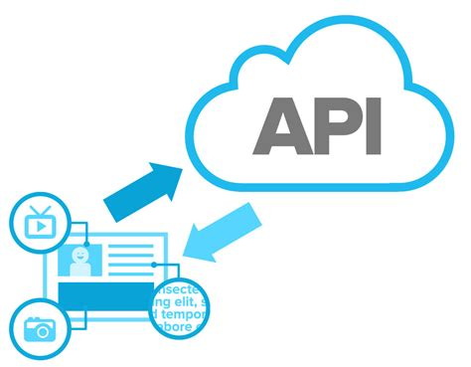
API Layer

Slide 5
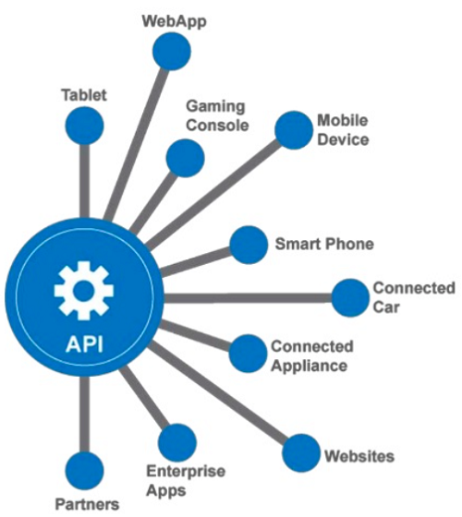
API Layer
Like the UI of an ASP.NET MVC (or any web platform and pattern), the API endpoints should not know about the Domain knowledge or Data Access

Slide 6
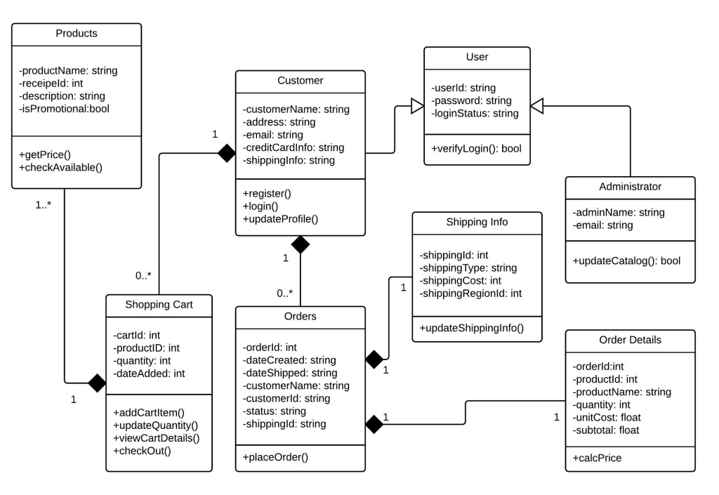
API Layer
Should interact with consumers with ApiModels to ensure the greatest flexibility

Slide 7

Domain Layer

Slide 8
Domain Layer
Contains both my Entity models and my ApiModels for the solution.

Slide 9

Domain Layer
Contains all my interfaces for Data Retrieval so I can keep a well defined standard for my data access.

Slide 10

Domain Layer
Allows me to use Dependency Injection for Repositories

Slide 11
Domain Layer
Think of the Domain Layer as the Supervisor!

Slide 12

Data Layer

Slide 13

Data Layer
Where all the heavy data lifting happens

Slide 14
Data Layer
I have everything defined based on Interfaces from the Domain Layer

Slide 15

Data Layer
I use Entity Framework Core but I can use anything that is .NET Standard 2.0

Slide 16

Data Layer
I also Mock up a data layer for testing

